Slide 1
Reproducible Reporting
Session 2
Patrick Mathias
July 16, 2020

Slide 2
July 16 2020 | Session | Instructor
1:00 pm - 1:30 pm | Instructor Introductions, Introduction to technology | Amrom Obstfeld
1:30 pm - 2:15 pm | Introduction to R and RStudio | Joe Rudolf
2:30 pm - 3:15 pm | Reproducible Reporting | Patrick Mathias
3:30 pm - 5:00 pm | Data Visualization | Stephan Kadauke
July 17 2020
1:00 pm - 2:30 pm | Data Transformation | Amrom Obstfeld
2:45 pm - 4:15 pm | Statistical Analysis | Dan Herman
4:30 pm - 5:00 pm | Advanced Reporting | Patrick Mathias
Notes:
In this block, we’ll dive deeper into one or the main generators of knowledge and understanding in data analysis: visualization.

Slide 3
Goals
Understand why reproducible reporting is important
Learn to work within R Markdown for reproducible reports
Objectives
Create an R Markdown document and generate different types of output files
Practice modifying each component of a R Markdown file

Slide 4
Typical Data Science Pipeline
From R for Data Science (https://r4ds.had.co.nz/introduction.html)
Notes:
We refer to R for Data Science, a free text available online frequently
Provide a nice model for the typical process of analyzing data to communicate
Focus for this hour is the machinery that allows us to capture this whole process in a way that is reproducible and also can communicate to others

Slide 5
Your Turn #1
List 3 benefits of doing data analysis using spreadsheet software like Microsoft Excel
List 3 drawbacks/problems with doing data analysis using spreadsheet software like Microsoft Excel

Slide 6
Why is reproducibility important?

Slide 7
Replication vs Reproduction
Replication: other people collect new data
Scientific gold standard
Difficult and time-consuming
Reproduction: other people analyze the same data
Does not by itself validate the analysis …
Has been proposed as a minimal standard
Notes:
Focus of learning the skills we’re teaching today isn’t strictly research
But we should define 2 terms frequently discussed in the research world: Replication and Reproduction.
Replication: other people collect new data and reach the same conclusions
This is the scientific gold standard but is also difficult and time-consuming.
Reproduction: other people analyze the same data and reach the same conclusions
Reproduction does *not* show by itself that the study is valid. There could still be problems with external validity of the conclusions, however, since it’s theoretically so much easier than going out there and doing an entirely new study, reproducibility has been proposed as a minimal standard to examine the scientific validity of the conclusions of a study.
And as the data analysis part of a study becomes more complex, reproducibility of the data analysis becomes more important.

Slide 8
Case
37 y/o M informatician with PMH of email overload disorder
Request from informatics staff:
“Please provide detailed data from your 2 year old analysis of total departmental effort spent performing test cancellations for a SBAR calling out the need to invest effort in duplicate checking rules for the ongoing EHR implementation project”
Analysis is in an Excel file but original raw data is nowhere to be found
Consider the above scenario, but with someone else performing the original analysis
Would it be less work to start from scratch and rewrite the analysis?
Notes:
Programming couse but we probably have a fair number of clinicians
Let’s talk about a case

Slide 9
Point-and-Click Is Not Reproducible
Interactive tools do not record user actions
Manual documentation is error-prone
Manual analyses cannot be repeated on new data sets or shared with collaborators
Computer code can precisely document each step of the analysis
Notes:
A critical barrier to reproducibility is the widespread use of graphical user interface “point-and-click” type software.
These interactive tools don’t record user actions.
Even if you try to manually document every action you take in MS Excel, it’s usually not complete enough for other others to retrace your steps without having to make a lot of assumptions.
Another important drawback of manual data analysis is its inefficiency. If you want to analyze a new or even slightly different set of data (and most of the time you do a complex analysis, you will!) you’ll have to start over and do everything again.

Slide 10
Why YOU Should Do Data Analysis Reproducibly
“Can we redo the analysis with this month’s data?”
“Why do the data in Table 1 not seem to agree with Figure 2?”
“Why did I decide to omit these six samples?”
Your closest collaborator is You from 6 months ago
(But you don’t answer e-mails)
Notes:
Here’s what I think are some of the most important reasons to make sure my work is reproducible.
…
* …
On a more serious note - if you’re analyzing clinical data and might reasonably change patient management based on your findings, that makes it so much more important that you take steps to assure your analysis is free of errors.

Slide 11
Using R for Reproducibility
Programming in R (or another language) allows one to reproduce analysis steps exactly or perform same analysis on new data
Better practice is to create documentation about analysis to accompany and explain code
Best practice is include documentation and code in one place

Slide 12
Using R Markdown to Support Reproducibility
Notes:
R Markdown is a tool that facilitates programming in R and integrating documentation in the same place you are programming

Slide 13
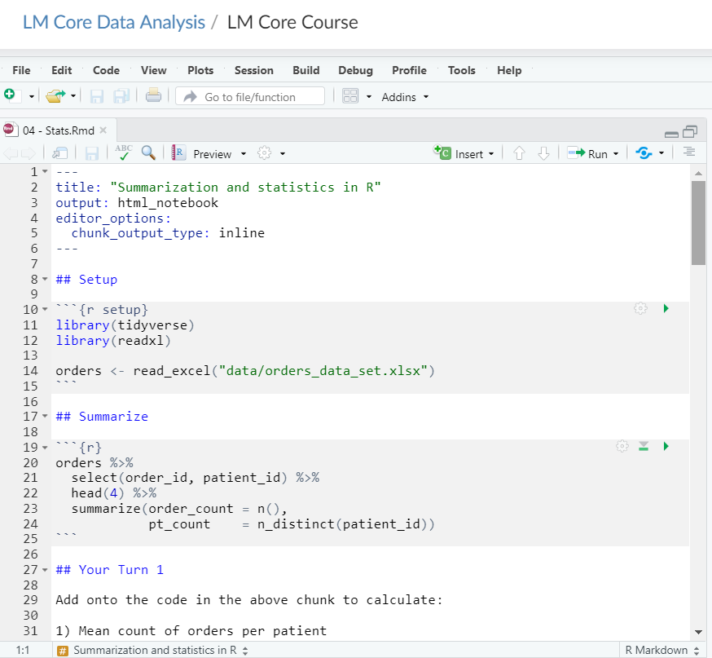
Header
Code chunk
Text

Slide 14
Header
Starts and ends with 3 dashes
Title in quotes
Output format
Notes:
You’ve created your first markdown document!
Let’s jump back to the file and take a closer look at the components
When you open a new document Rstudio auto-generated a header section that has the metadata you provided
This controls the output – if you decide to change the title, for example, you can modify here and the output document will be changed

Slide 15
Text
Include hyperlinks with [text](link) format
1 asterisk for italics (*italics*)
1 asterisk for italics (*italics*)
2 asterisks for bold (**bold**)
Hyphens (-bullet 1) for bullet points
Notes:
Another component of the file is the text
These are the white background areas and are intended to hold your non-programming text to explain an analysis, for example
Distinct from a document editor like Microsoft Word in that there is no point and click formatting
But it can parse Markdown, a lightweight markup language that is pretty easy to learn
Here are a few nuggets on formatting on this slide

Slide 16
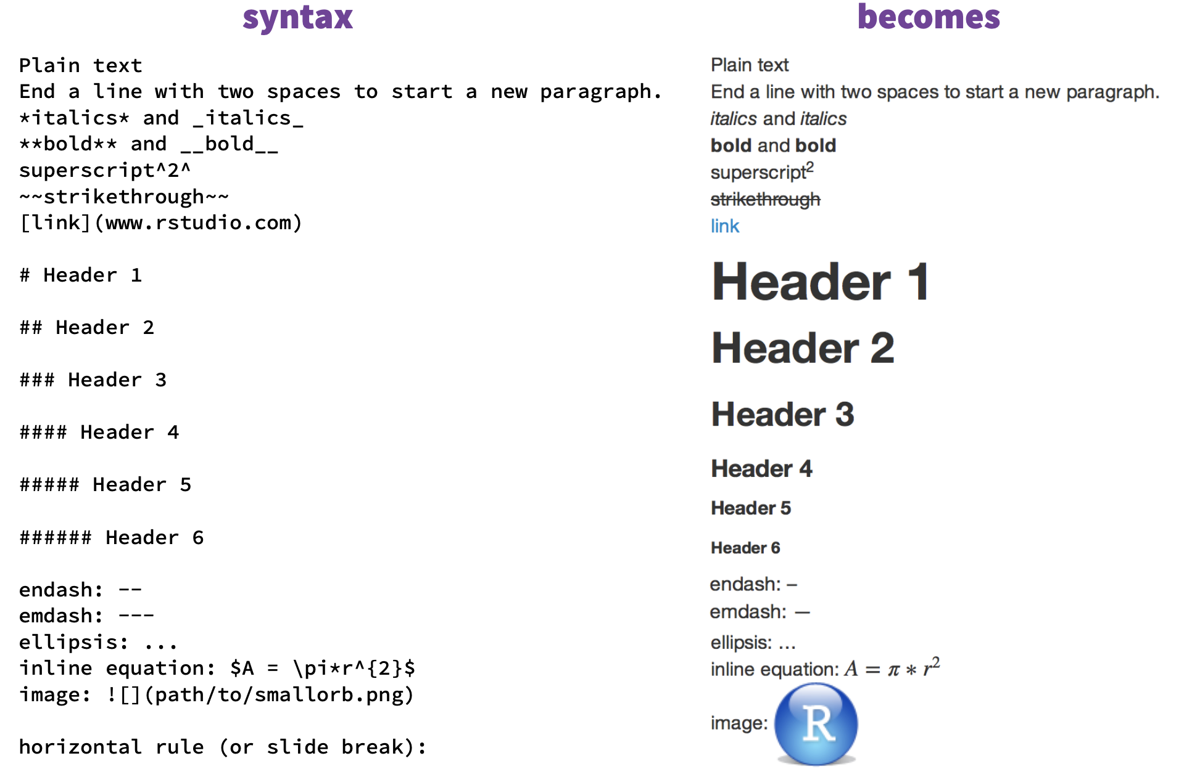
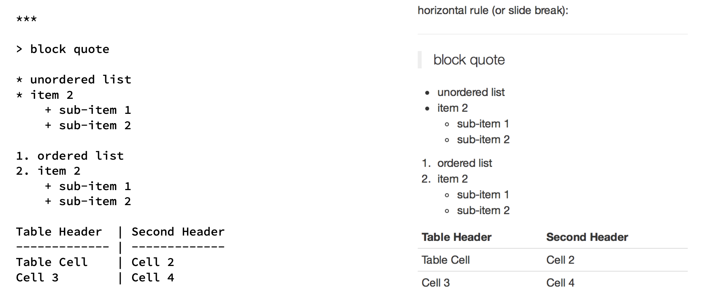
https://www.rstudio.com/wp-content/uploads/2015/02/rmarkdown-cheatsheet.pdf
Notes:
There is an R Markdown cheat sheet that includes most of the Markdown syntax in one place

Slide 17
Your Turn #2
Open up an R Notebook per guidance on next few slides.
Change the title of your R Notebook to “My First R Notebook” by modifying the header.
Add your name as the author by adding another line to the header:
author: “Your Name”
Add a second level heading (##) at the end of the notebook called “My Calculation”
Notes:
Let’s practice a little markdown
In practice what I’ve asked you to do is redundant since you can include this info in the header but it is good practice

Slide 18
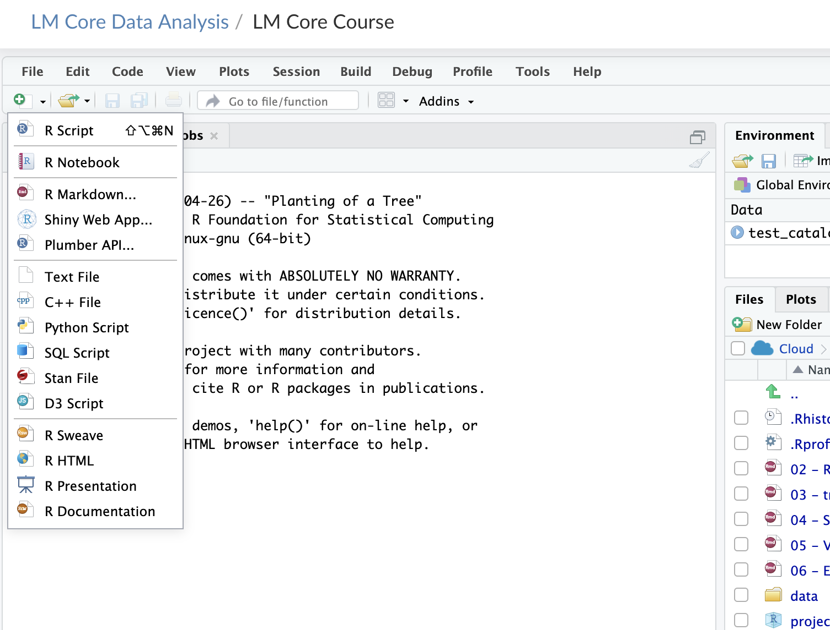
Step 1
Step 2

Slide 19
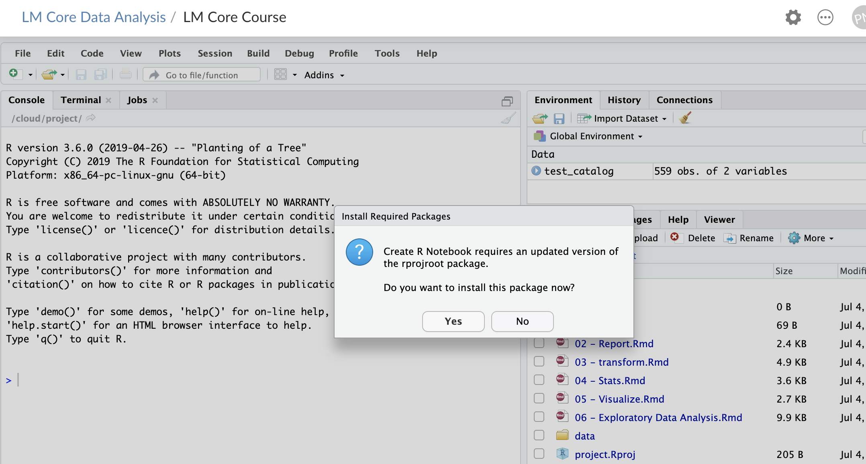
You may see this screen – click yes

Slide 20
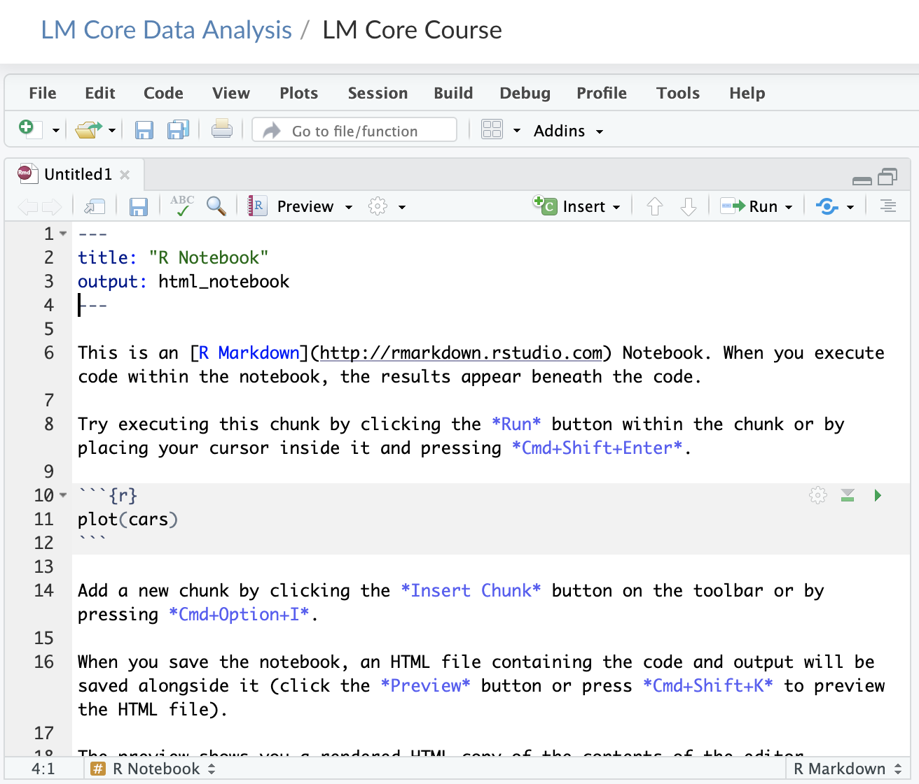

Slide 21
Your Turn #2
Open up an R Notebook per guidance on next few slides.
Change the title of your R Notebook to “My First R Notebook” by modifying the header.
Add your name as the author by adding another line to the header:
Author: “Your Name”
Add a second level heading (##) at the end of the notebook called “My Calculation”
Notes:
Let’s practice a little markdown
In practice what I’ve asked you to do is redundant since you can include this info in the header but it is good practice

Slide 22
Code chunks
Language
Chunk name
Open/close with 3 backticks
Run chunk
Code in body of chunk
Notes:
So where does the code go?
We place these in “chunks” that are executable independently and have a very unique syntax
Backticks (top left of your keyboard) open and close code chunks

Slide 23
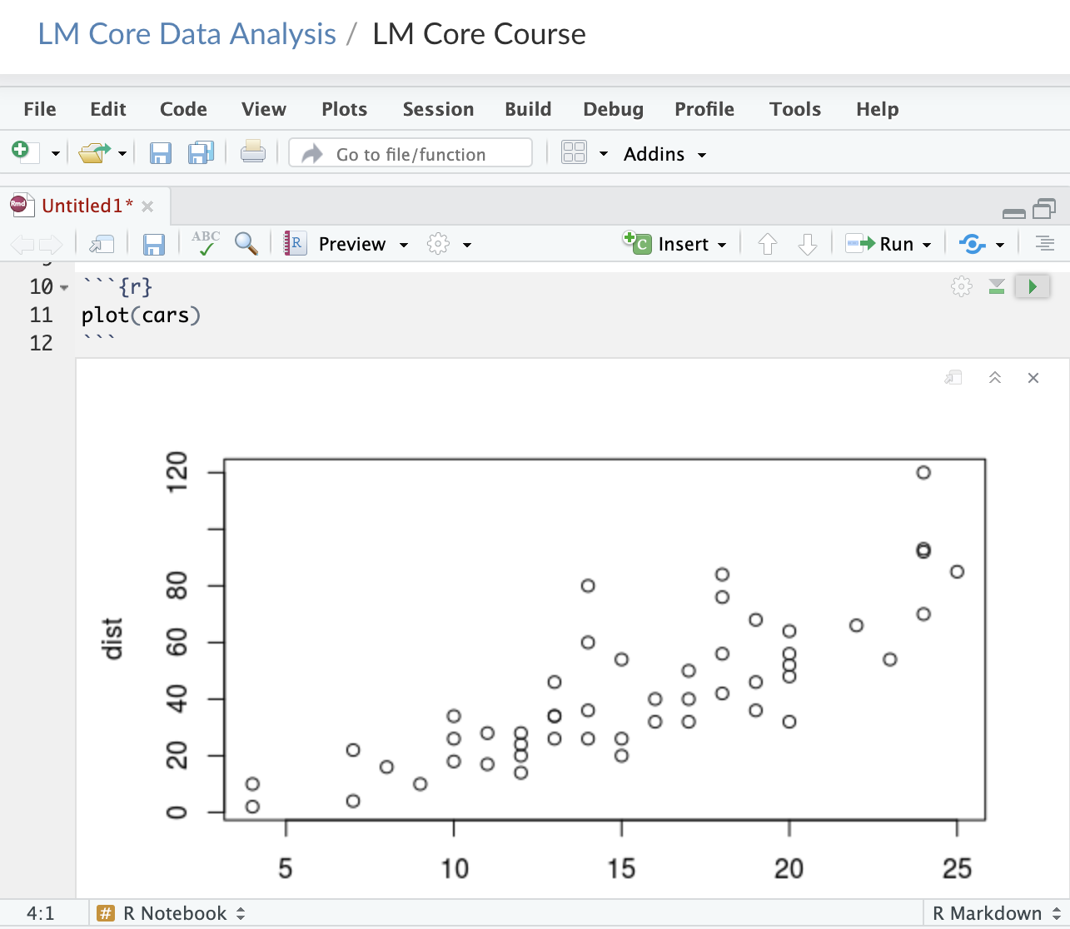
Run code chunk

Slide 24
Your Turn #3
1. Under your new “My Calcuation” heading, insert a code chunk into white space using Insert button on top right of code window
2. Type the following in the grey box of your new code chunk:
mean(c(10, 20, 30))
3. Execute code chunk by pressing Run button on top right of code chunk
Notes:
Annoying to type 3 backticks every time you want to insert a chunk so let’s walk through doing this with the Rstudio editor

Slide 25
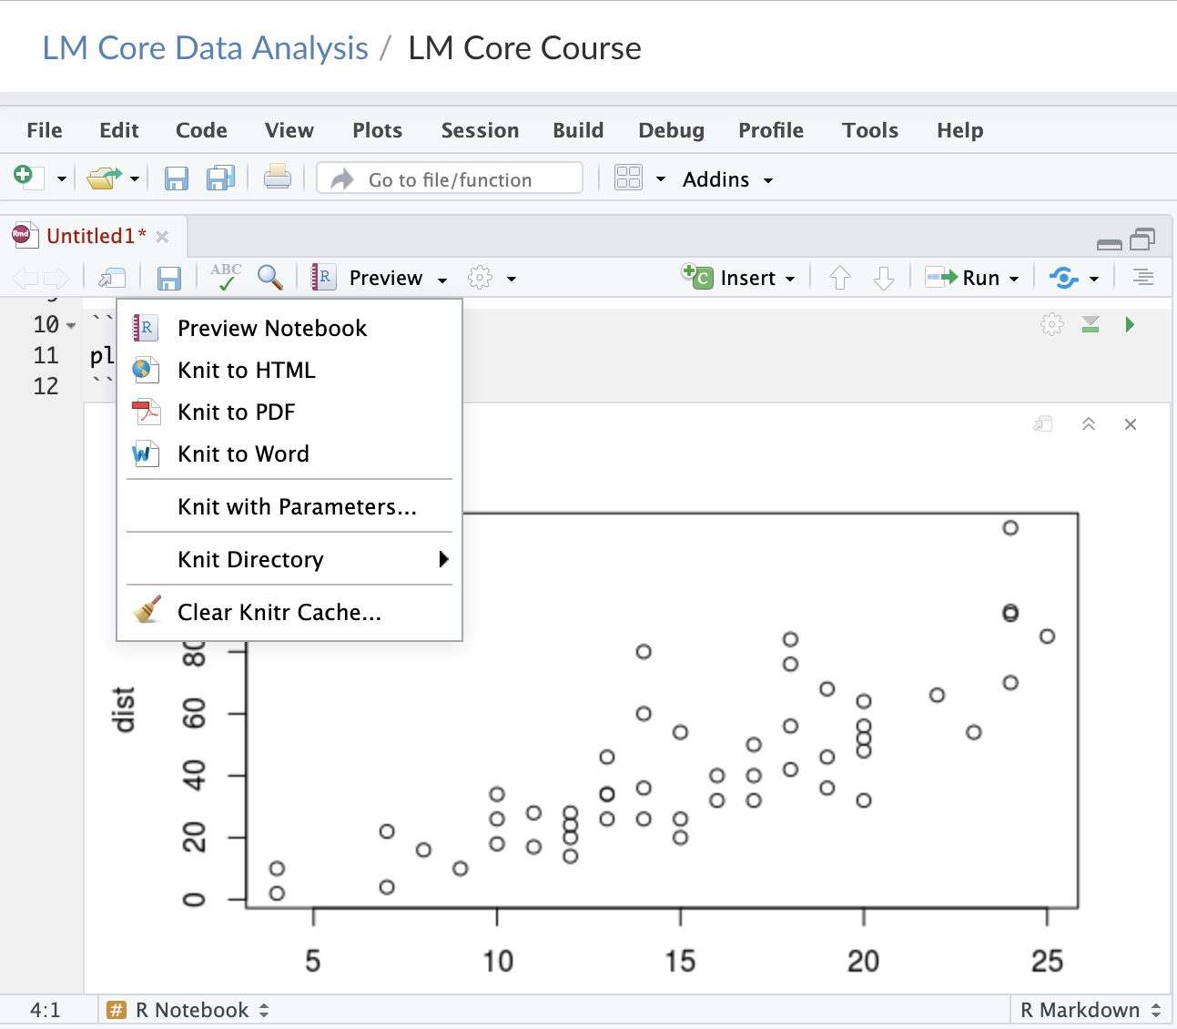

Slide 26
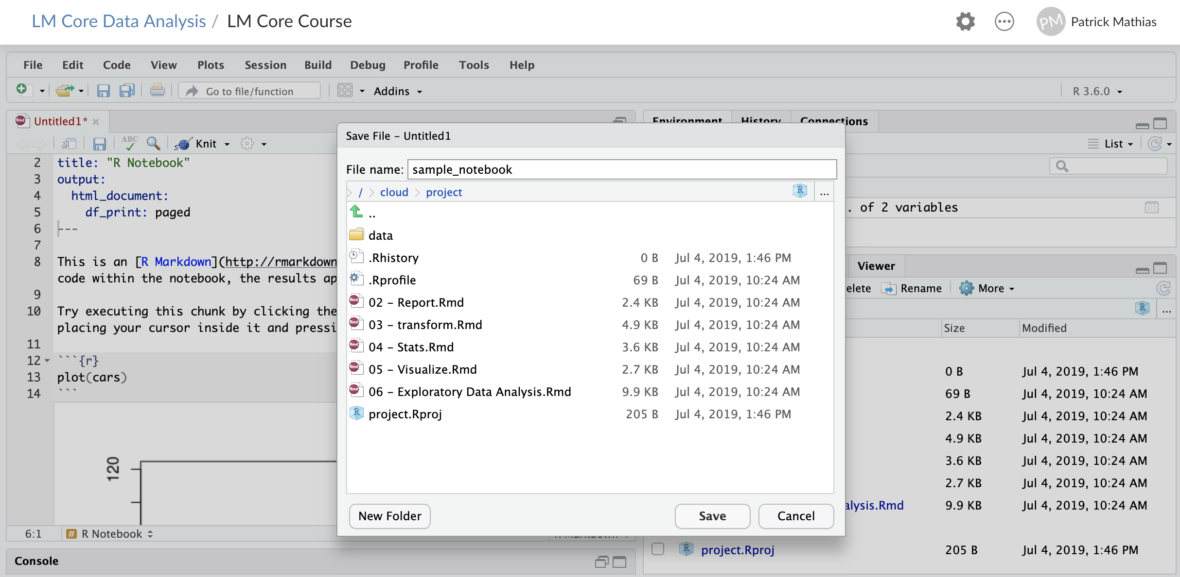

Slide 27
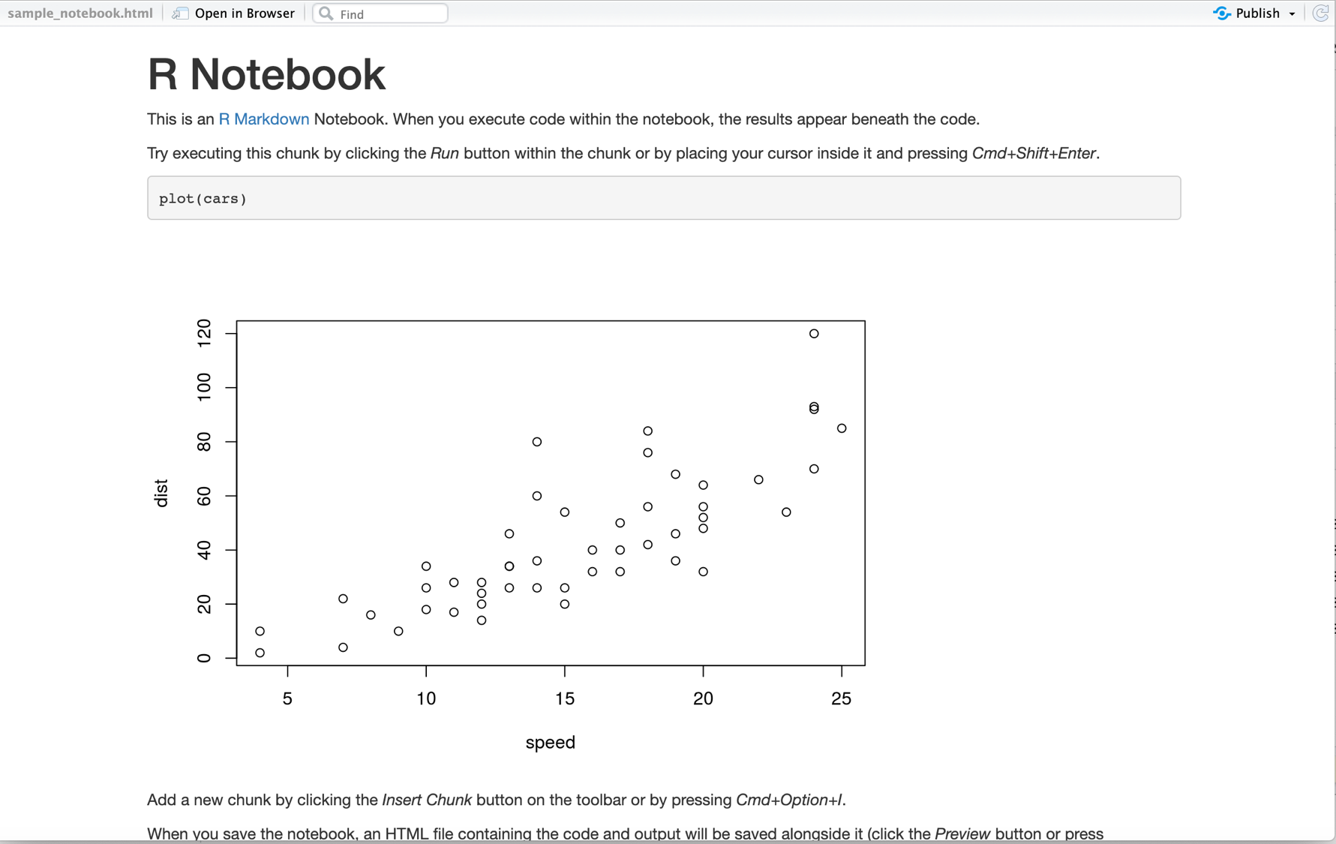

Slide 28
What Else?
Notes:
Now that you’ve learned to create some basic plots that can be embedded into your R Markdown document we’ll wrap up experimenting with other document types

Slide 29
Why name Code Chunks?
Jump between chunks
Notes:
Can name code chunks but you don’t have to
Why might you want to?

Slide 30
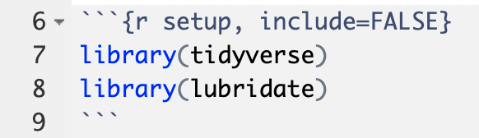
“Setup” Chunk & Chunk Options
chunk name (optional)
“chunk option”
don’t show code in rendered document
for dealing with dates
Notes:
“setup” this is a label for a this code chunk, completely optional
Include = FALSE. This is a chunk option that tells R what to do with this particular chunk to render it. If you check the back of the R Markdown ref guide, you’ll see that if you set the chunk option include = FALSE R will run the code chunk but not include its code in the final document. The setup chunk is usually hidden, well, because it’s ugly.
Again, please run each code chunk as we go. Otherwise you will get errors further down below since the lower down code depends on higher up code.

Slide 31
Chunk options

Slide 32
Keyboard Shortcuts
Insert a code chunk into white space within your open R Markdown document using:
Windows: CTRL+ALT+i
Mac: COMMAND+OPTION+I
Execute using shortcuts:
Windows: CTRL+SHIFT+ENTER
Mac: COMMMAND+SHIFT+ENTER

Slide 33
Multiple Output Formats are Available
Pandoc universal document converter can create multiple document types:
html
pdf
docx
Can also create presentations and dashboards
Including Powerpoint (most recent version of RStudio)

Slide 34
Creating a pdf report
R & RStudio require additional packages to create a nicely formatted pdf report
Behind the scenes, R will use a markup language called LaTeX to turn your markdown into the pdf
Install the tinytex package with the following commands:
install.packages('tinytex’)
tinytex::install_tinytex()

Slide 35
Goals
Understand why reproducible reporting is important
Learn to work within R Markdown for reproducible reports
Objectives
Create an R Markdown document and generate different types of output files
Practice modifying each component of a R Markdown file

